Slide 1
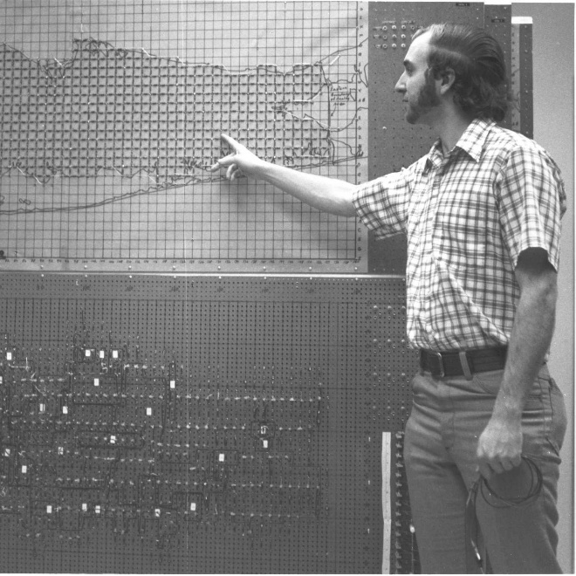
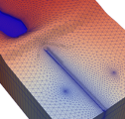
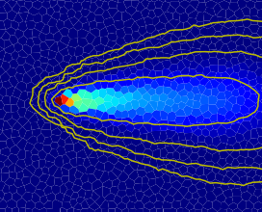
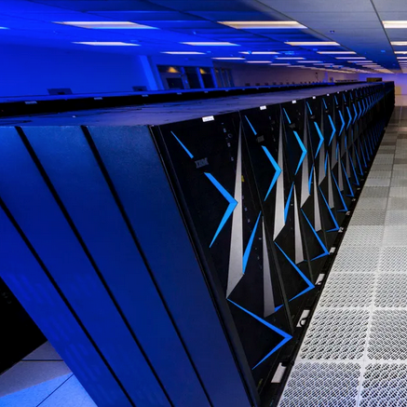

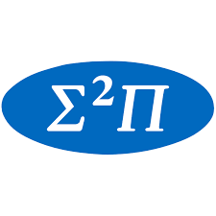




Overview of MODFLOW 6 Newest capabilities & ongoing developments

Slide 2
MODFLOW 6 Objectives
Provide a single program that consolidates simulation capabilities in the numerous MODFLOW variants, including, for example:
MODFLOW-2005
MODFLOW-LGR
MODFLOW-NWT
MODFLOW-USG
SEAWAT
GSFLOW
Support multiple model instances and multiple model types in a single simulation
Provide a platform for extending MODFLOW into a configurable hydrologic simulator

Slide 3
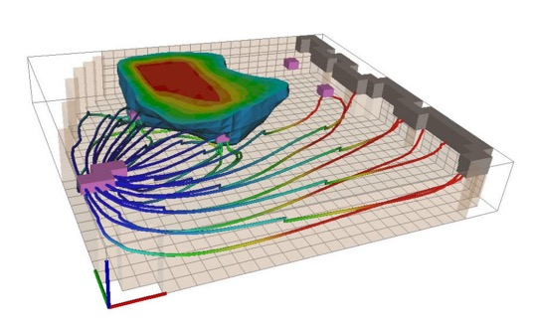
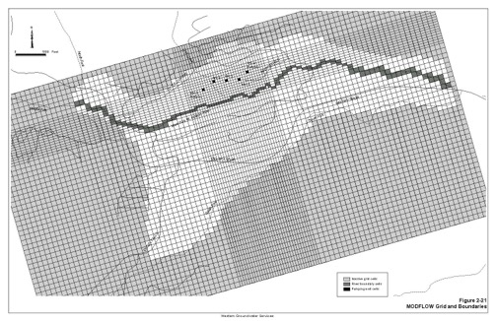
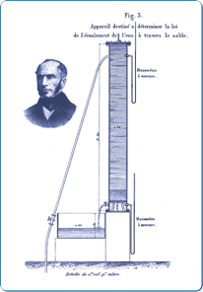
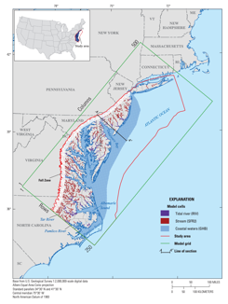
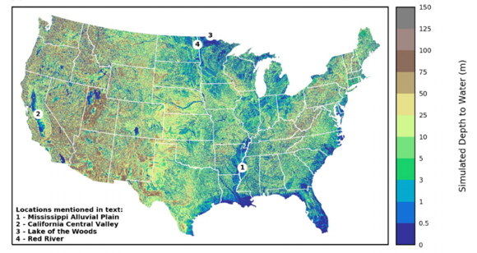
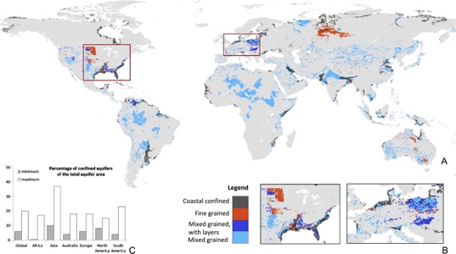
Range of Scales for MODFLOW Applications
bench
site
subregional
regional
national
global

Slide 4
MODFLOW 6 Components
Simulation
Solution Types
Implicit
Explicit
Model Types
Groundwater Flow (GWF)
Groundwater Solute Transport (GWT)
Groundwater Energy Transport (GWE)
Particle Tracking (PRT)
In development
Overland Flow (OLF)
Channel Flow (CHF)
Solutions
Models
Packages
Exchanges
Timing

Slide 5
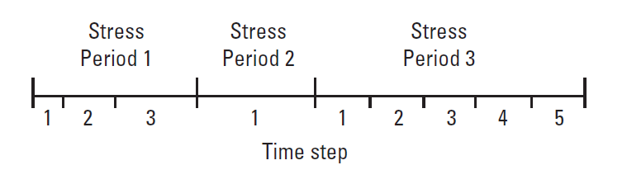
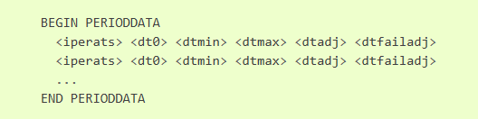
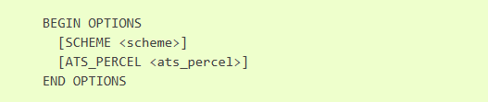
Temporal Discretization
Stress periods, Time steps
Equidistant, or TSMULT
Adaptive time stepping (ATS)
Reduced when solver fails, or
Get maximum dt from Models
ATS input:
ADV input:

Slide 6
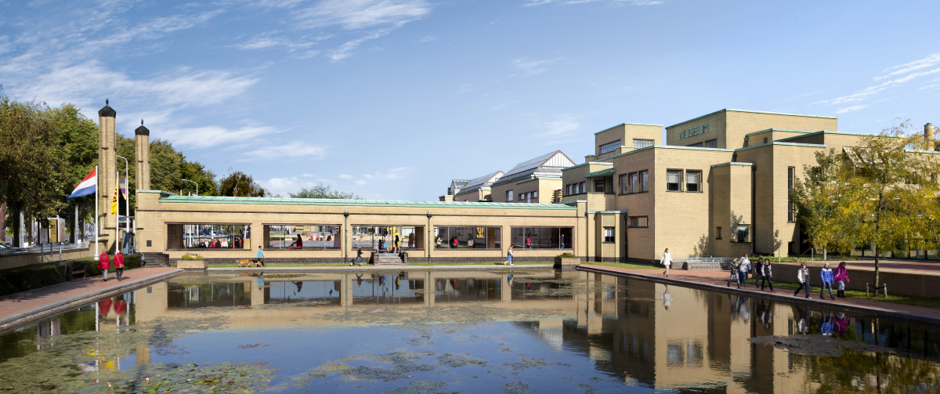
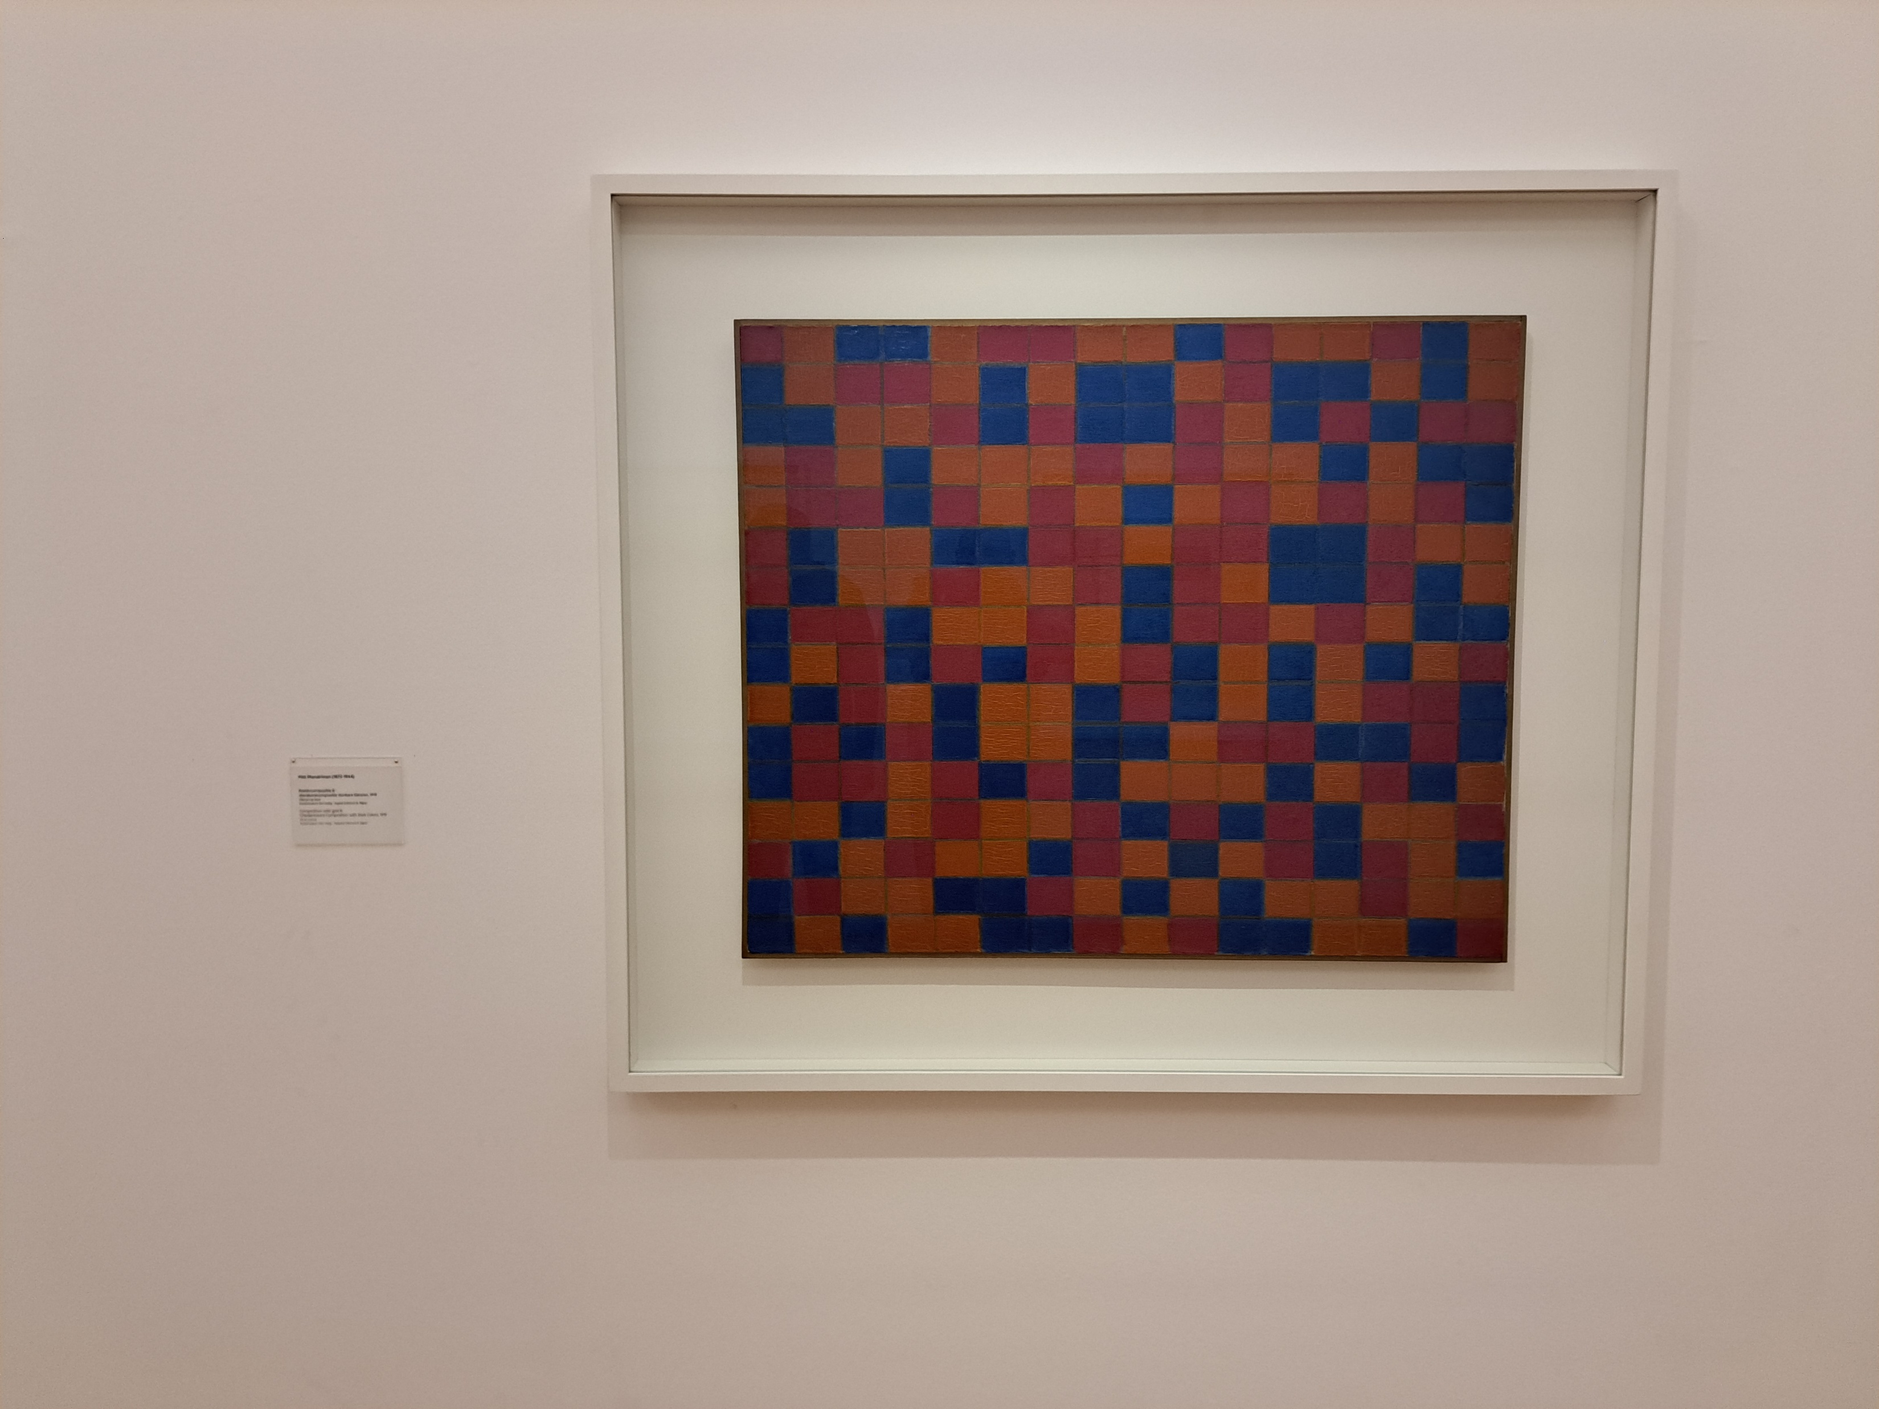
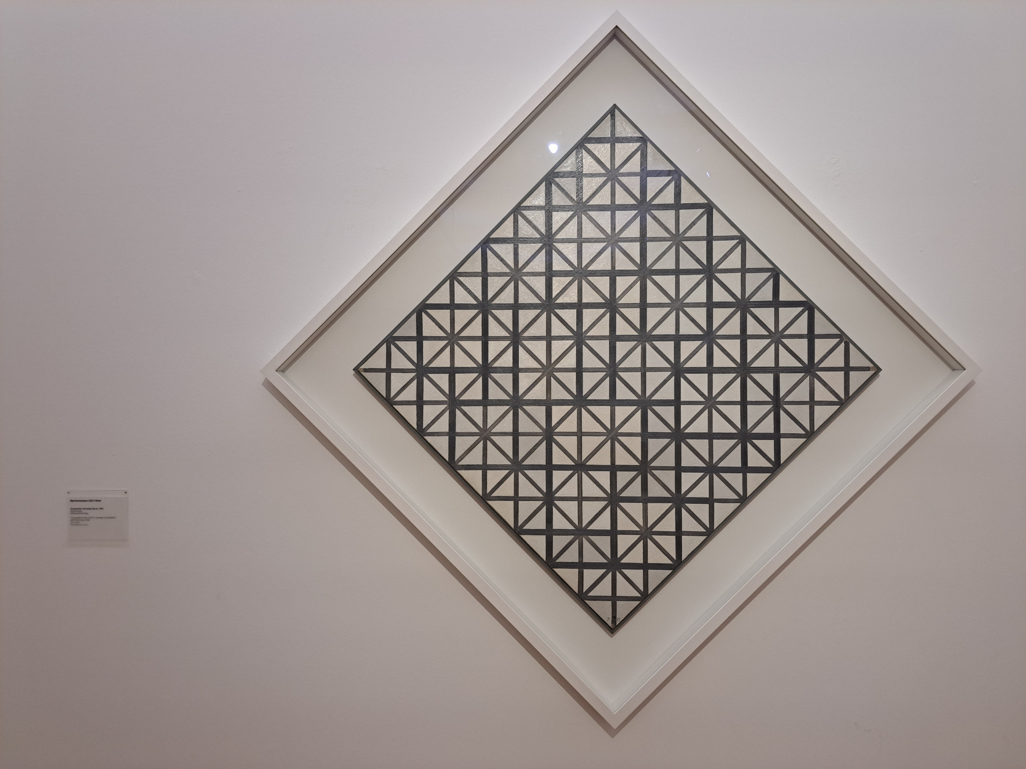
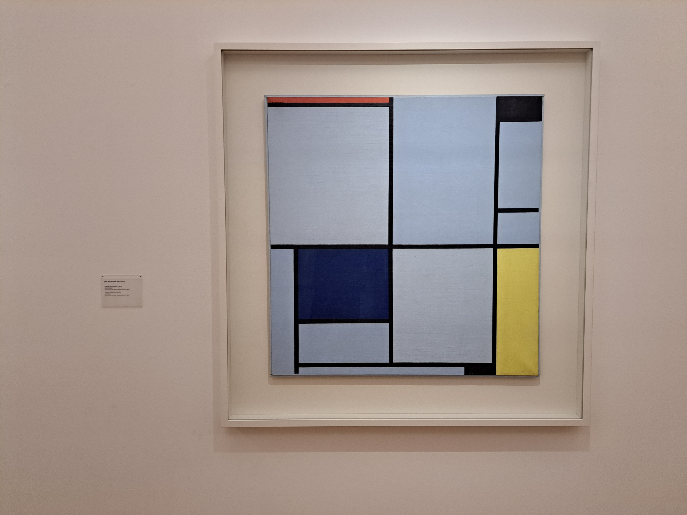
Spatial Discretization
Rectilinear – Discretization DIS
Unstructured – Discretization by Vertices DISV (layered)
Unstructured – Discretization by Connections DISU (prismatic)

Slide 7
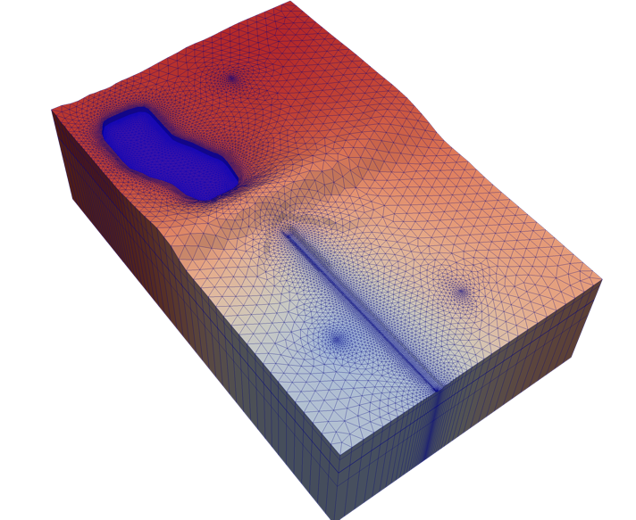
Groundwater Flow (GWF) Model
Highlights
Newton or standard formulation
Full 3D anisotropy (XT3D)
Compaction and subsidence (CSUB)
Multiple stress packages of the same type
Advanced stress packages (SFR, LAK, MAW, UZF)
Water mover (MVR)

Slide 8
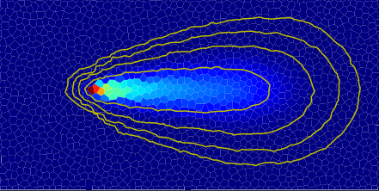
Groundwater Transport (GWT) Model
Highlights
Advection, dispersion, sorption, decay/growth
Mobile and immobile domains
Advanced packages (SFT, LKT, MWT, UZT)
Water mover for transport (MVT)

Slide 9
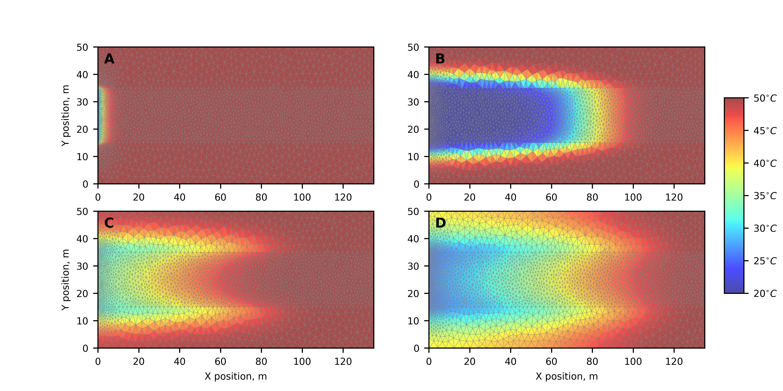
Groundwater Energy (GWE) Transport Model
Heat-transport equivalents a thing of the past!
Facilitates smoother parameter estimation investigations
GWE more readily supports
Geothermal investigations
Ecological investigations
Better leveraging of inexpensive temperature observations for improved calibration of a GWF model

Slide 10
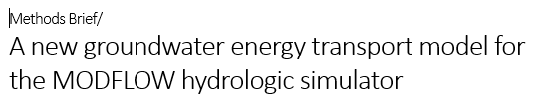
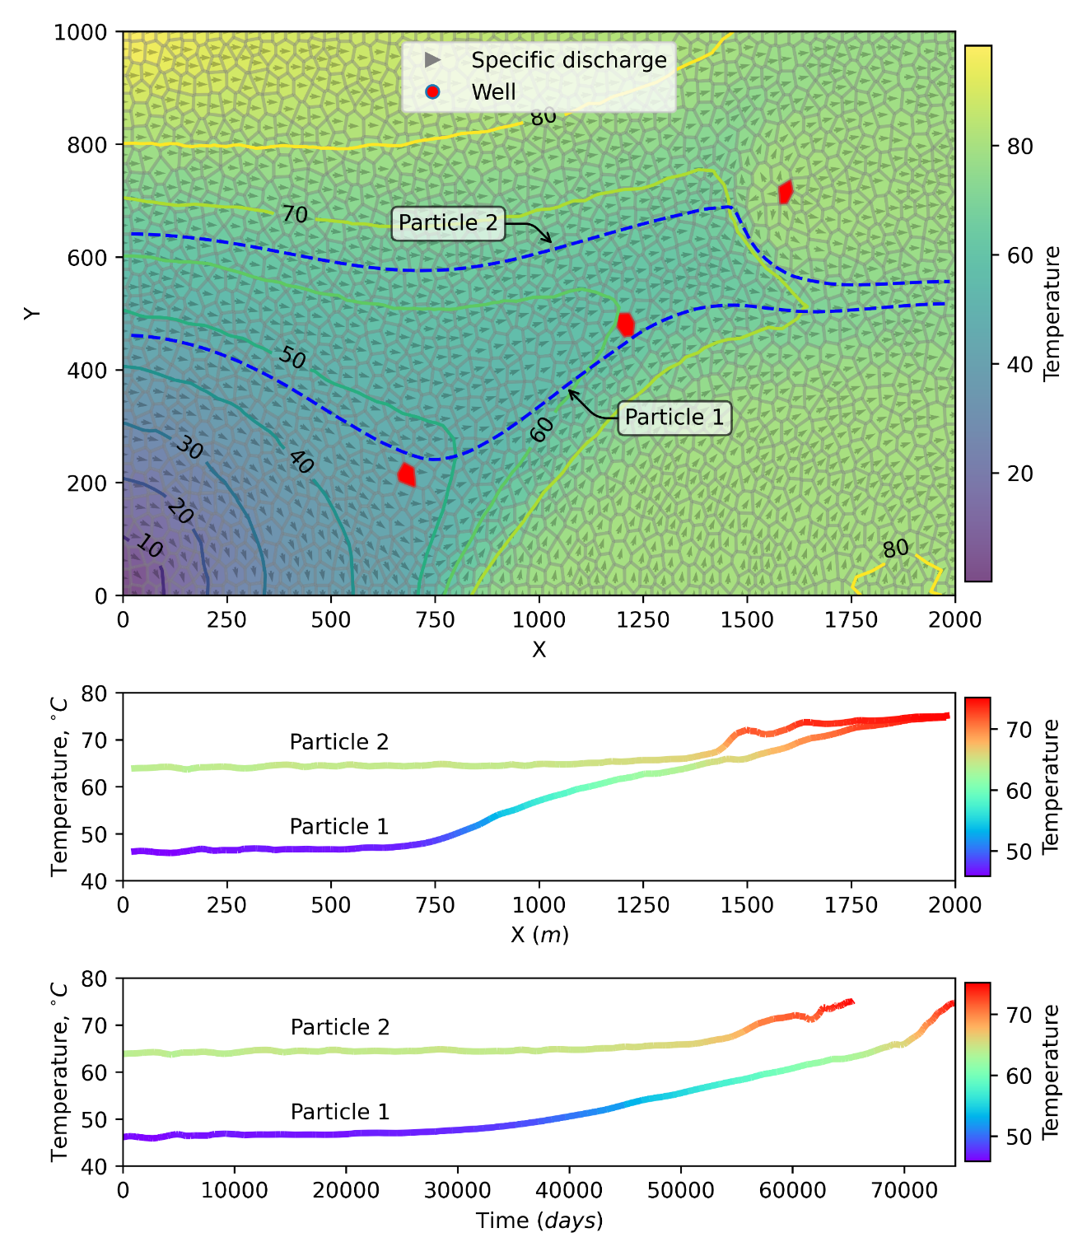
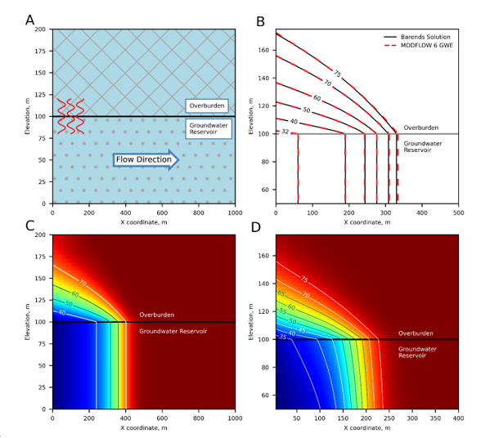
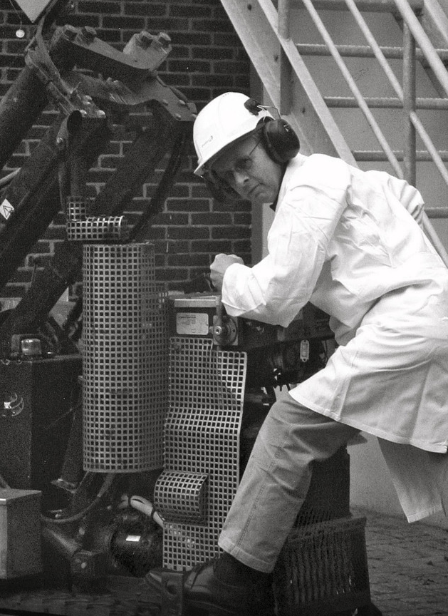

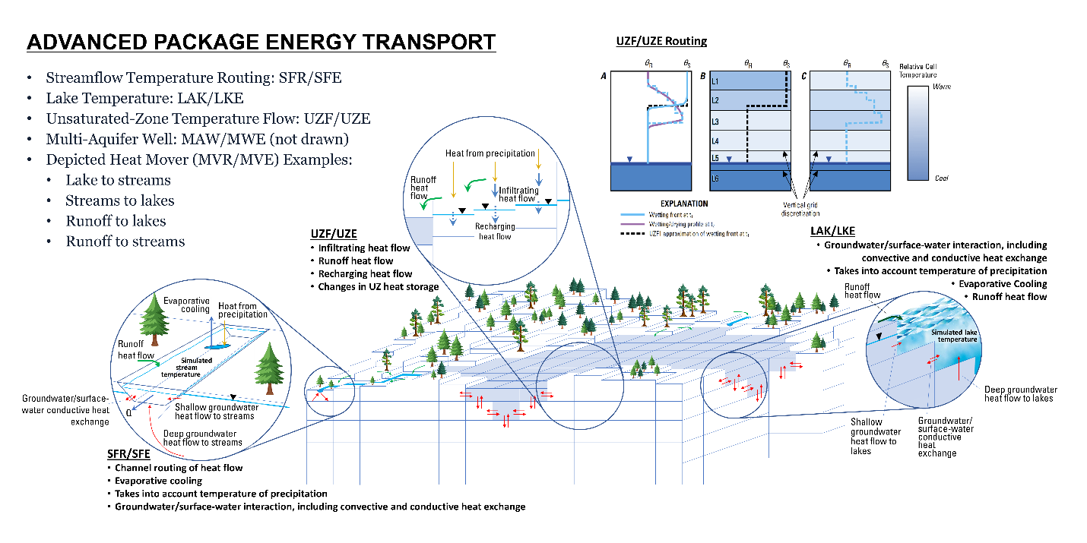
Groundwater Energy (GWE) Transport Model
GWF + GWE + PRT
Barends, F.B.J. 2010. Complete Solution for Transient Heat Transport in Porous Media Following Lauwerier's Concept. Society of Petroleum Engineers Annual Technical Conference and Exhibition, Florence, Italy. SPE-134670-MS https://doi.org/10.2118/134670-MS.

Slide 11
Exchanges
Communication between any two models occurs through an ”exchange”
Exchange types:
GWF-GWF: connects two GWF Models
GWT-GWT: connects two GWT Models
GWE-GWE: connects two GWE Models
GWF-GWT: provides the simulated flows from a GWF Model to a GWT Model
GWF-GWE: provides the simulated flows from a GWF Model to a GWE Model
MODEL
EXCHANGE
MODEL

Slide 12
Solutions
Dependent variables for one or more models are calculated by a “solution”
A focus of MODFLOW 6 has been on the Iterative Model Solution (IMS)
IMS solves for head (GWF), concentration (GWT), temperature (GWE)
Explicit Model Solution (EMS) introduced for particle tracking (PRT)
SOLUTION
MODEL
EXCHANGE
MODEL

Slide 13
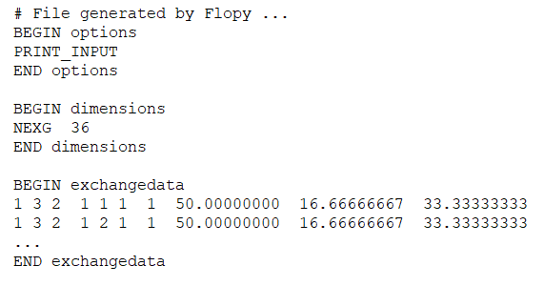
Exchange Data
Model 1
Model 2
Connect two GWF models by specifying a GWF-GWF Exchange in the configuration
Exchange file contains geometrical data for connection between neighboring nodes
L_{m}
Δw
m
L_{n}
n
Notes:
A user can couple two GWF models by specifying a GWF-GWF exchange. The exchange file contains geometrical data for how cells are connected across models.

Slide 14
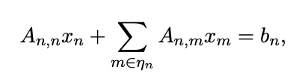
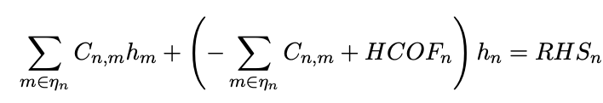
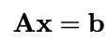
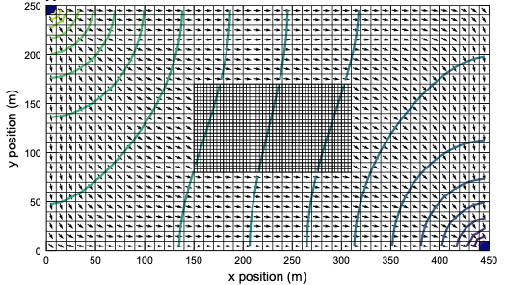
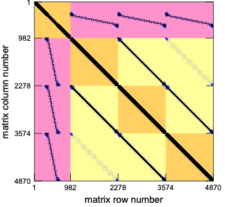
Generalized Control-Volume Finite-Difference Numerical Solutions

Slide 15
Single-Model Configurations
Simulation
Simulation
Temporal Discretization
Temporal Discretization
Numerical Solution
Numerical Solution
Groundwater Flow Model
Groundwater Transport Model

Slide 16
Multi-Model Configurations
Simulation
Simulation
Temporal Discretization
Temporal Discretization
Numerical Solution
Numerical Solution 1
Groundwater Flow Model 1
Groundwater Flow Model
Groundwater Flow Model 2
Numerical Solution 2
GWF-GWF Numerical Exchange
Groundwater Transport Model
GWF-GWT Exchange

Slide 17
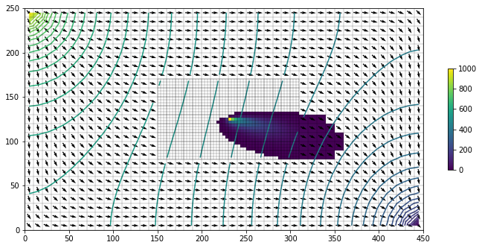
Multi-Model Configurations
Simulation
Temporal Discretization
Numerical Solution 1
Groundwater Flow Model 1
Groundwater Flow Model 2
GWF-GWF Numerical Exchange
Numerical Solution 2
Groundwater Transport Model 1
Groundwater Transport Model 2
GWT-GWT Numerical Exchange
GWF-GWT
Exchange 1
GWF-GWT
Exchange 2

Slide 18
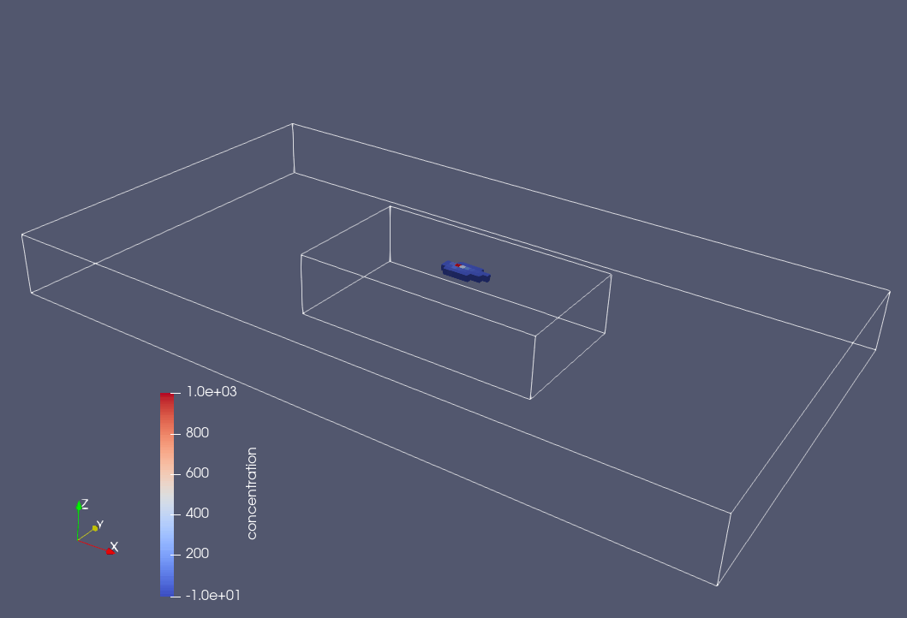

Slide 19
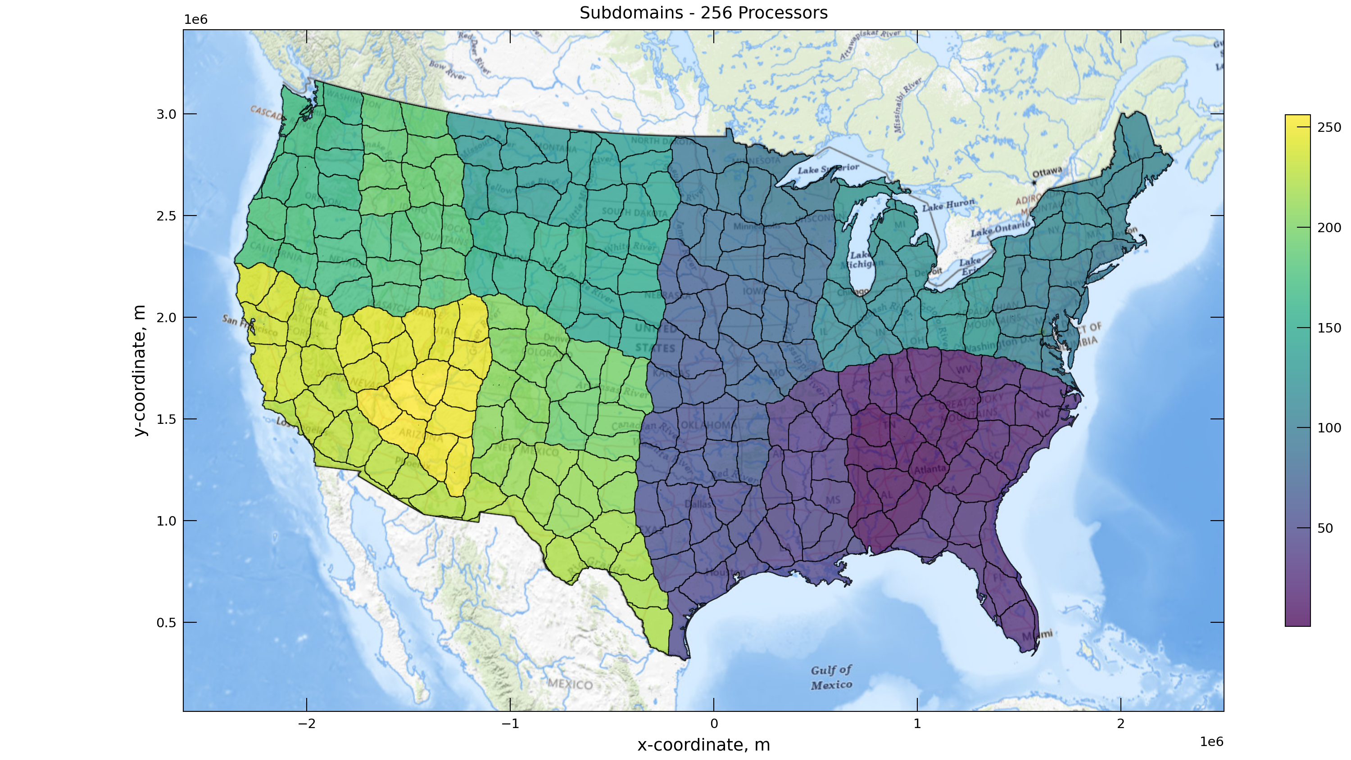
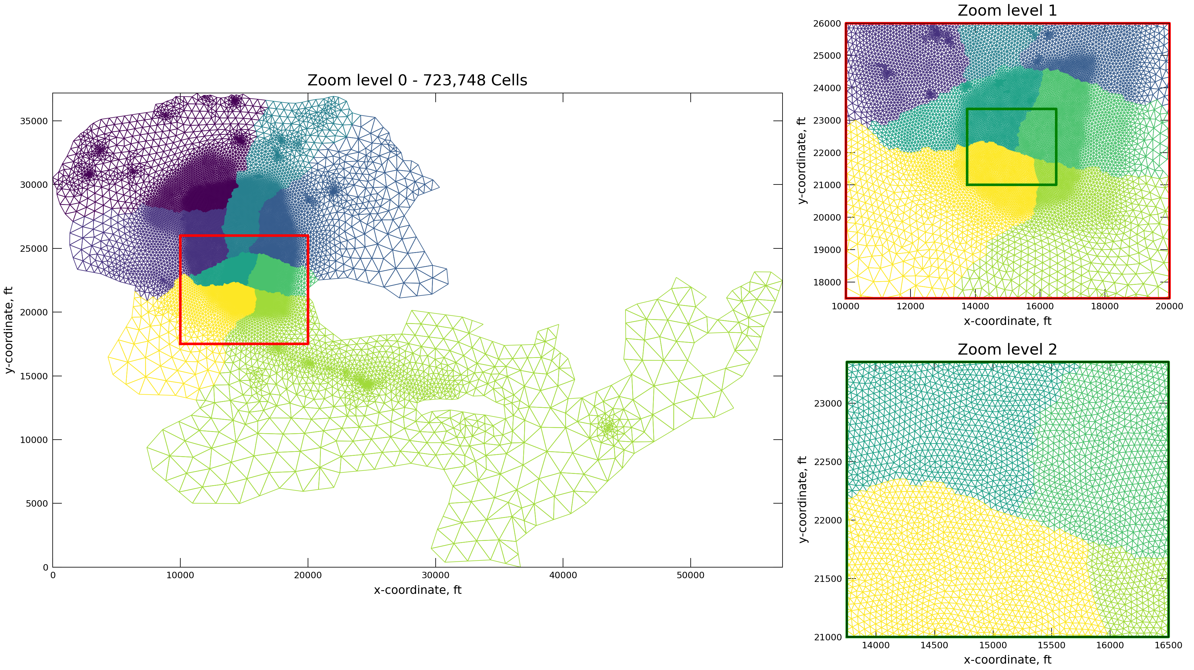
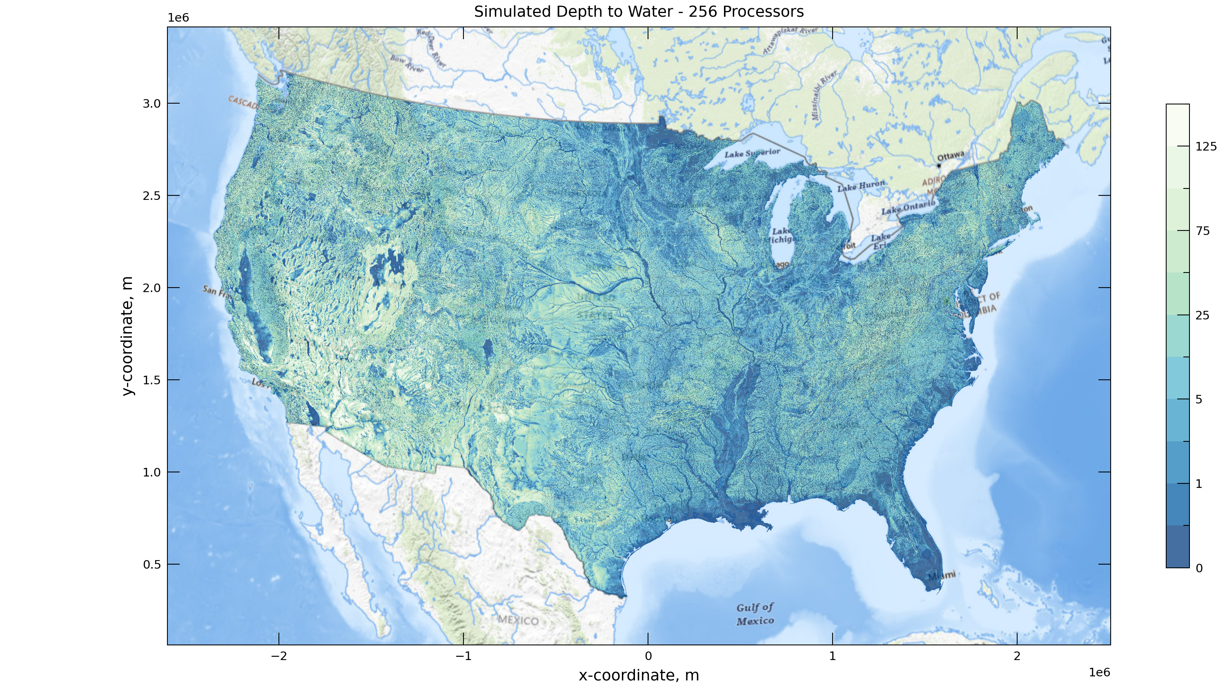
Parallel Computing
Large national/continental scale models
High resolution, regional models
Targeting HPC as well as laptops
Runtimes:
1* core: > 250 hrs
250 cores: 1.7 hrs
Model of a Regional Groundwater Basin in Southern California,
Tetra Tech 2023

Slide 20
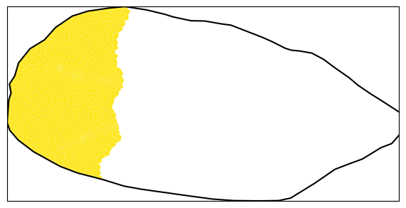
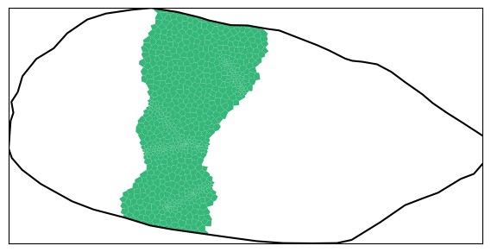

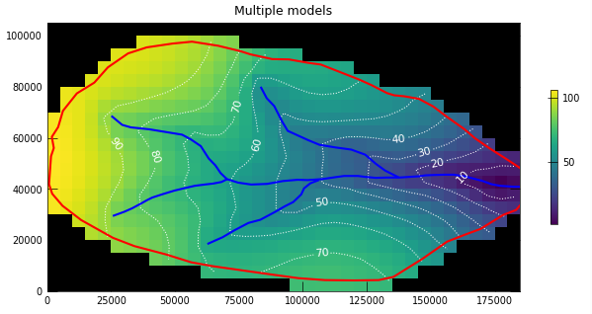
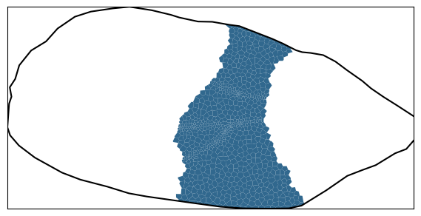
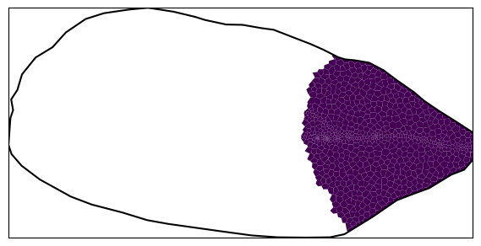
Parallel Computing: density dependent
Serial Simulation
Parallel Simulation
Flow_1
Trans_1
Flow_2
Trans_2
Flow
Trans
Flow_3
Trans_3
Flow_4
Trans_4

Slide 21
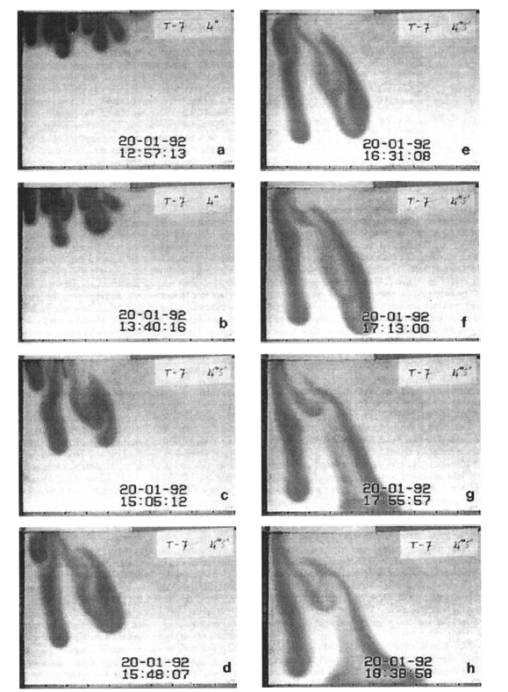
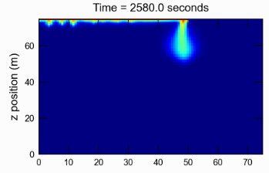
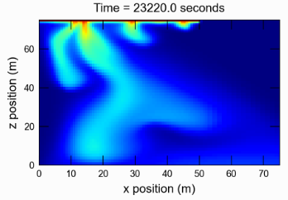
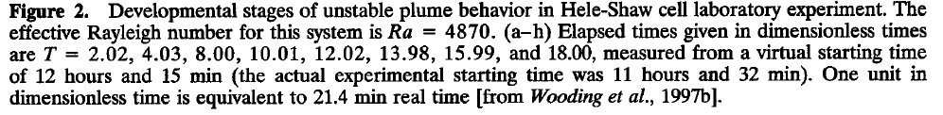
Salt Lake
Coupled variable-density flow and solute transport simulation
Experimental Hele-Shaw Cell Study of Wooding et al.
From the “MODFLOW 6 Examples”:

Slide 22
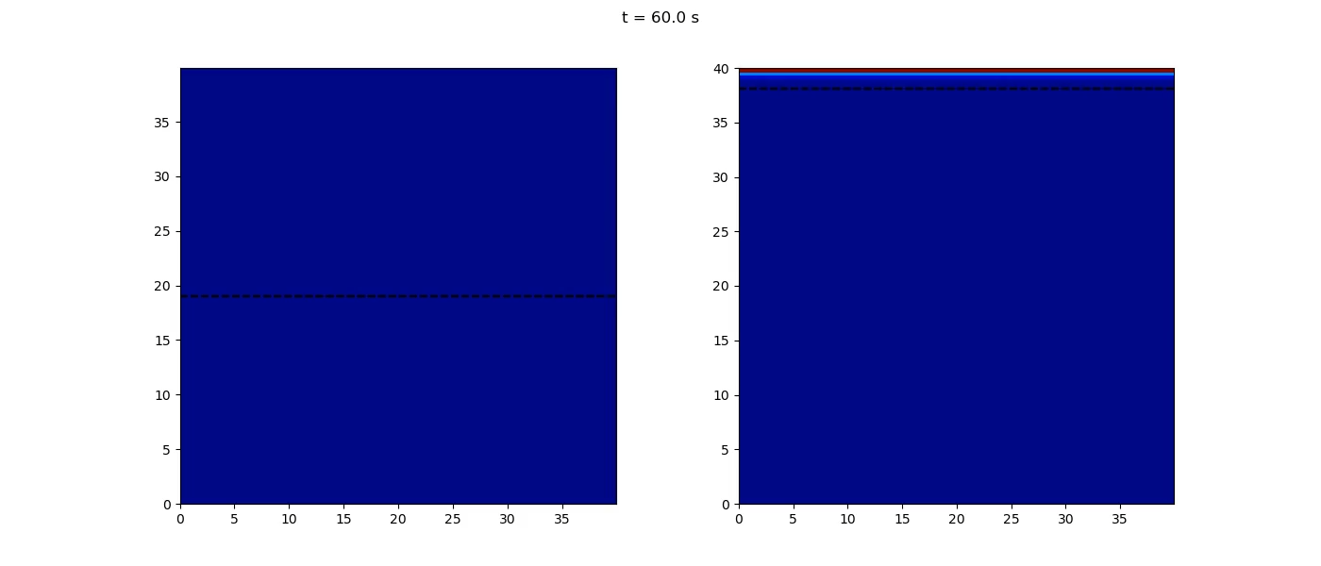
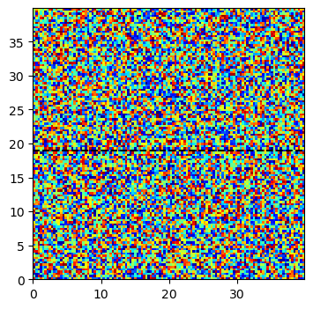
Parallel Salt Lake in 3 dimensions
GHB

Slide 23
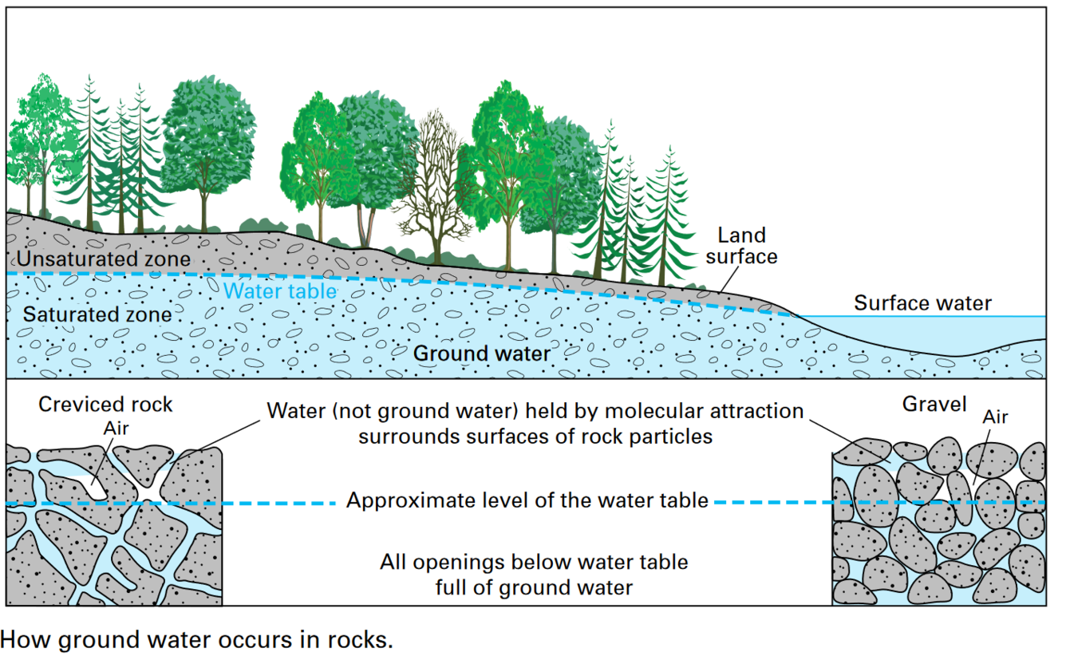
Unsaturated Zone: 3D Richards
MODFLOW 6: confined and unconfined groundwater
NPF: saturated fraction S_{F} (which is not saturation)
N
N
z
dry
NPF
UZR
s

Slide 24
UZR package
Integration with NPF based on the premise that
Richards Equation for variably saturated conditions, smoothly becomes standard NPF flow equation when fully saturated
Very similar to MODFLOW-USG
Benefits
Apply Richards Eq. only when unsaturated
Works with Transport, PRT
Multi-model and Parallelization supported
Newton option
Adaptive Timestepping

Slide 25
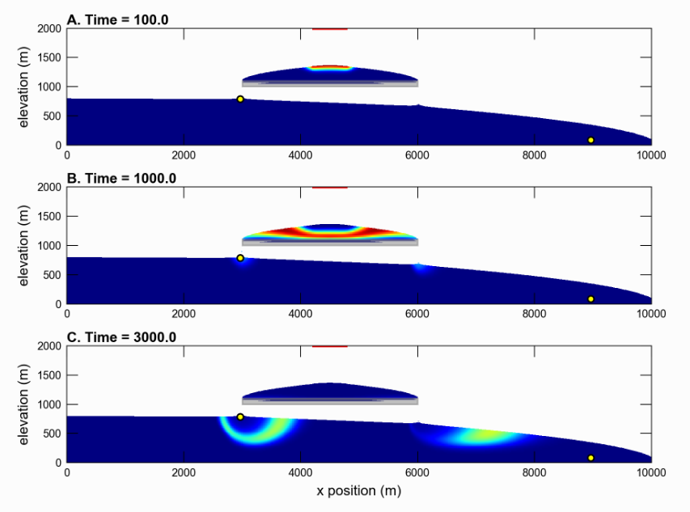



Unsaturated Zone: Keating Problem
Water table problem with perched aquifer
Unconfined flow and solute transfer in MODFLOW 6 through “dry” cells with ‘Newton’ option

Slide 26

Unsaturated Zone: Keating Problem
First 3D Richards simulation with the UZR package:

Slide 27

Channel and Overland Flow Models
Two new surface water flow models are under development
Channel Flow (CHF) Model
Overland Flow (OLF) Model
These are not GWF “packages”; they are separate “models” with their own discretization and packages
The models will run by themselves or coupled with another model

Slide 28


Motivators
MOD-HMS
SWR Process for MODFLOW

Slide 29



Diffusion Wave Model
One-dimensional channel flow
Two-dimensional overland flow
Manning’s equation

Slide 30


Channel Flow (CHF) Model Discretization
Discretization by Vertices in 1D (DISV1D)

Slide 31




Overland Flow (OLF) Model Discretization
Structured Grid in 2D (DIS2D)
Discretization by Vertices in 2D (DISV2D)

Slide 32


Channel Cross Section (CXS) Package

Slide 33







Surface-Water Benchmarks

Slide 34


Delaware River Basin
MODFLOW

Slide 35

Channel Flow (CHF) Simulation

Slide 36
MODFLOW 6 Timeline
2013 – Initiated development
2017 – First release with the Groundwater Flow (GWF) Model
2020 – MODFLOW Application Programming Interface (API)
2020 – Release of Groundwater Transport (GWT) Model
2023 – Release of parallel simulation capabilities
2024 – PRT, GWE, NetCDF
2025/26 – Richards, Surface Water, …

